Slide 1
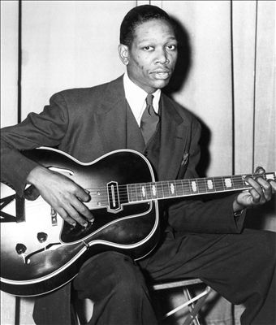
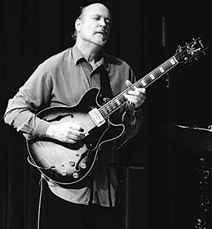
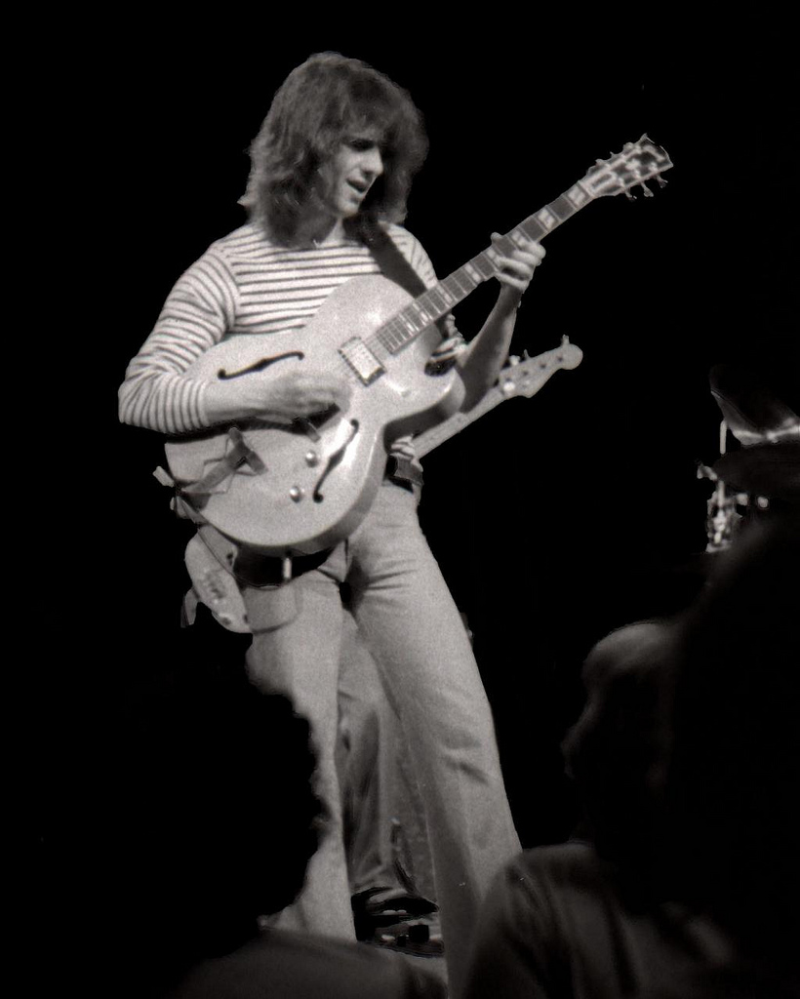
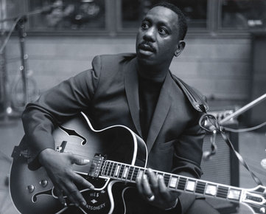
Pioneers of Jazz Guitar
Saint Xavier University Jazz Guitar Workshop Day
November 22, 2014
Dr. Shawn Salmon, Director of Jazz Studies

Slide 2
Early Guitar in Jazz
Guitar was not used in jazz band as much as the banjo due to the low volume of the acoustic guitar
Main function of the banjo or guitar was rhythmic support
Johnny St. Cyr (1890-1966)
Combined the neck of the guitar with the body of a banjo
Played early 1920s with New Orleans jazz groups King Oliver, Louis Armstrong, and Jelly Roll Morton
Played chord-bass rhythmic style similar to ragtime piano

Slide 3
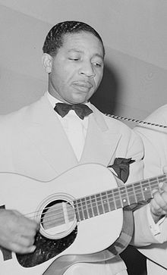
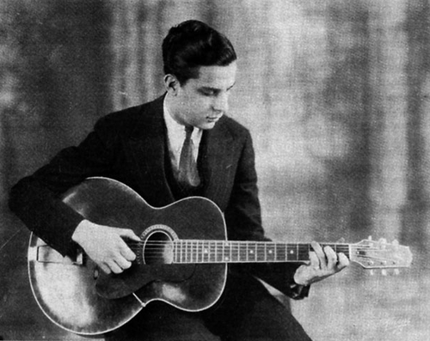
Early Guitar in Jazz
Lonnie Johnson (1889-1920)
Brought the guitar as a solo instrument
Recorded with Louis Armstrong 1927
“Hotter Than That”
Recorded with Duke Ellington
“The Mooche”
Rooted in early blues improvisation
Eddie Lang (1902-1933)
Influenced by Johnson
Background in classical guitar
Recorded with Johnson, Bing Crosby, Bessie Smith
“Handful of Riffs”

Slide 4
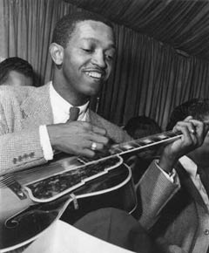
Big Band Guitar
Fred Guy (1897-1971)
Guitarist for Duke Ellington
Bernard Addison
Guitarist for Fletcher Henderson and Coleman Hawkins
Freddie Green (1911-1987)
Joined Count Basie Band 1937
Set standard for swing era guitarists
Solid quarter note rhythms with the bass (Walter Page)
Played acoustic archtop
Chords mainly 2 notes (3rds and 7ths)
Freed Basie to lightly comp chords as “fills” and not play in stride-style
“Lil’ Darlin’”
“Shiny Stockings”

Slide 5
Django Reinhardt
Born Belgum (1910-1953), French gypsy, began playing banjo and violin, guitar age 12
1928 fire accident crippled left hand, loss the use of 2 fingers
Developed amazing technique using 2 remaining fingers
Joined Le Quintette Da Hot Club De France 1934 with violinist Stephane Grappelli
Improvisations show gypsy influence in melodies and “swing” was slightly different
Help bring the guitar to a single-note melodic instrument in jazz
Recorded with Duke Ellington later in life
Mostly still an acoustic player

Slide 6
Django Reinhardt
Tiger Rag - 1934

Slide 7
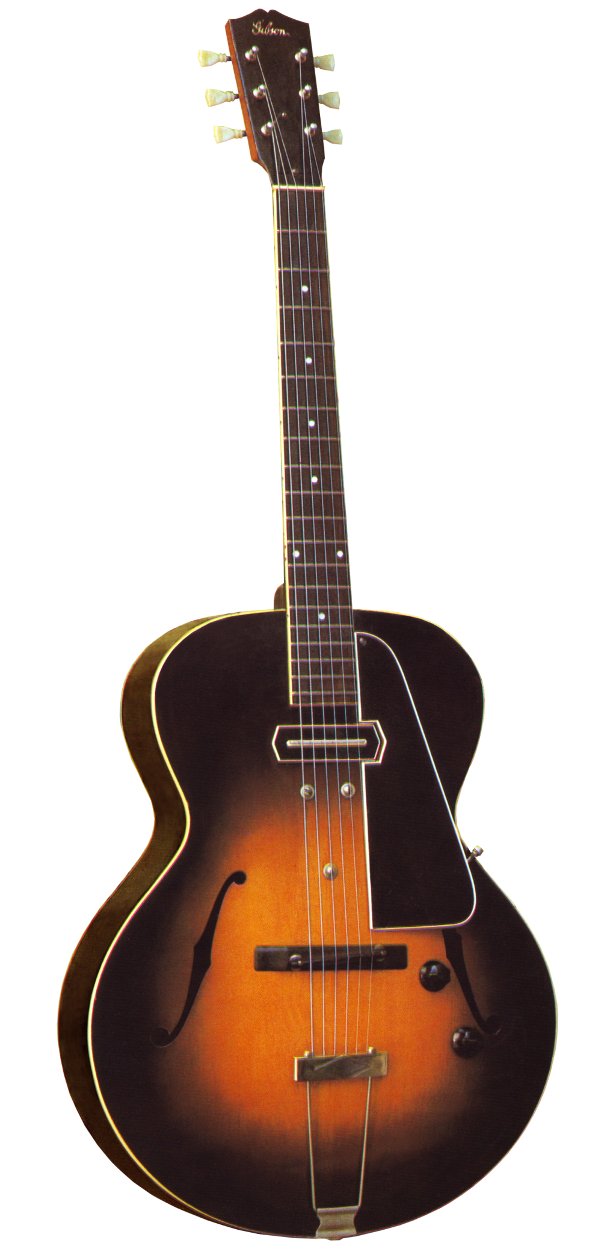
Gibson ES-150
1935 the Gibson Guitar Co. perfects the electro-magnetic pickup
String vibration within a magnetic field causes an electrical current at the same frequency to be reproduced out an electric amplifier
Eddie Durham (1906-1987) a trombonist with the Count Basie band, but recorded one of the earliest electric guitar solos with the Jimmie Lunceford in 1935
“Hittin’ the Bottle”

Slide 8
Charlie Christian
Born in Texas (1916-1942) moved to Oklahoma City
Heard by talent scout John Hammond in 1939
Distinct solo lines, driving 8th-note melodies, advanced harmonies
First to give the guitar a distinct voice in jazz
Miles Davis called him the real inventor of Bebop
Worked with Dizzy Gillespie and others in afterhours jam session in N.Y.
Hired by Benny Goodman
Record with Goodman sextet and septet and big band
Died of t.b. in 1942
Changed the guitar’s roll in jazz in 18 months

Slide 9
Charlie Christian
Solo Flight (1941)
Benny’s Bugle
Must have albums: The Genius of the Electric Guitar Box Set Solo Flight

Slide 10
The Guitar in Bebop
The Guitarists follow the path set by Christian and Charlie Parker
Barney Kessel (1923-2004)
Took a lesson with Christian, recorded with Parker in 1947
Joined the Oscar Peterson Trio 1952 (piano, guitar, bass)
“On Green Dolphin Street” – The Poll Winners
Herb Ellis (1921-2010)
Replaced Kessel in the Peterson Trio
Often taped on the strings to create a percussive, bongo sound
Tal Farlow (1921-1998)
Strong adoption of bebop vocabulary for guitar
Joins vibraphonist Red Norvo Trio with Charles Mingus
Only recorded a few albums as leader
The Swinging Guitar of Tal Farlow and The Artistry of Tal Farlow (classic)

Slide 11
Chordal Stylists
Johnny Smith (1922-2013)
Used closed-position chord voicings to harmonize the melody
In-demand for both studio, classical, and jazz work
Moonlight in Vermont (1952) with Stan Getz
Extremely legato chordal phrasing
“The Boy Next Door”
Joe Pass (1929-1994)
Equally great as single-line improviser in the style of bebop
Recorded a series of albums in 1970s showcasing solo guitar technique
Virtuoso (vol.1-5), I Remember Charlie Parker and duets with Ella Fitzgerald and other artists
Multi-line technique combined chords, melody, walking bassline, blend of single-note improvisation and harmonies
“Cherokee”

Slide 12
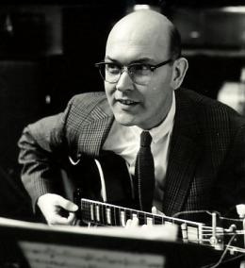
Hard Bop and Cool
Jim Hall (1930-2013)
Influenced by Charlie Christian, Django, and saxophonists Lester Young and Coleman Hawkins
Early groups included West Coast bands, Chico Hamilton, Jimmy Giuffie trio
Developed own understated approach to improvisation, focus on deep harmonic approach
Each improvisation was a composition
1962 Sonny Rollins’ The Bridge brought Hall greater attention
Guitarists were rarely used as the sole comping instrument
1962 duets with pianist Bill Evans Intermodulation and Undercurrent (Blue Note)
2000s recorded duets with Pat Metheny and Bill Frisell
“Stompin’ At the Savoy” – Jim Hall Trio

Slide 13
Wes Montgomery
John L. “Wes” Montgomery (1925-1968) inspired to buy his first electric guitar after hearing “Solo Flight”
Began playing in his 20s, practice Christian solos late into the night after working 2 jobs
Played with his thumb so not to wake his family and neighbors
First gigs were with his brothers, Buddy and Monk, who were established jazz musicians
Discovered by Cannonball Adderley, who helped get him signed to Prestige Records 1959
Developed unique style of improvisation – 3 tier approach
Single notes – octaves – chords
Improvisations are some of the most influential since Charlie Christian

Slide 14
Wes Montgomery
Must Have Albums:
The Incredible Jazz Guitar of Wes Montgomery
Full House
Introducing The Wes Montgomery Trio
Boss Guitar
Smokin’ At the Half Note
“Four On Six”

Slide 15
Other Hard Bop Guitarists
Grant Green (1931-1978) recorded almost exclusively with Blue Note Records 1960s
Solos perfectly blended bebop vocabulary with classic blues
Distinct 8th note feel
Recordings during late 70s blended funk and soul – often sampled by today’s hip hop artists
Grandstand, Solid, Live at the Lighthouse
Kenny Burrell (1931-) combined bebop with soul, blues, and gospel
Worked with Dizzy Gillespie while in college
Recorded with organist, Jimmy Smith – Back In the Chicken Shack, Organ Grinder Swing, House Party
Kenny Burrell and John Coltrane (1958) a classic of hard bop era
Midnight Blue, Guitar Forms, All Night Long
Teaches at UCLA

Slide 16
Fusion Guitarists
1969 Jazz begins to combine with the sound and rhythms of Rock and Roll
The guitar becomes a corner stone in the fusion groups
John McLaughlin (1942) records with drummer Tony Williams (Emergency) and Miles Davis (Bitches Brew)
British guitarist, tone and influence more rock than bebop or hard bop
Influence range from rock to free jazz and music of India
1971 formed fusion group The Mahavishnue Orchestra
Acoustic trio with fusion guitarist Al DiMeola and flamenco guitarist Paco De Lucia
Continues to record today, The 4th Dimension and Five Peace Band
Bird of Fire

Slide 17
Fusion Guitarists
Pat Metheny (1954) began playing guitar at age 13
One of the most original voices in jazz today
Recorded with own trio, free jazz with Ornette Coleman, classical music, folk and pop music with Bruce Hornsby and Joni Mitchell
At 17 was teaching at University of Miami
1976 album Bright Size Life with bassist Jaco Pastorius and drummer Bob Moses
Perfect combination of Wes Montgomery’s fluidness and Jim Hall’s lyric and harmonic approach
Used the chorus effect for softer tone than other fusion guitarists
1978 forms The Pat Metheny Group with keyboardist Lyle Mayes
Combine jazz with Brazilian, folk, rock, and country influences
Advanced guitar and technology – synclavier, midi-guitar, 42-string Pikasso guitar
2009 Orchestrion album is just him and instruments that play by themselves
Link

Slide 18
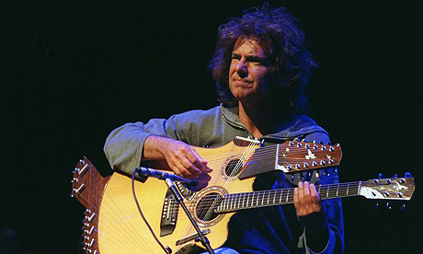
Fusion Guitarists
Pat Metheny recommended albums
Bright Size Life
The Pat Metheny Group, Offramp, First Circle, The Road to You
Secret Story
Unity Band
Trio-Live
Metheny/Mehldau
I Can See Your House From Here
Question and Answers
Day Trip
Quartet Live with Chick Corea
Passengers (Gary Burton Quintet)

Slide 19
Fusion Guitarists
John Scofield (1951) recorded with late Miles Davis fusion groups 1980s
Sound has fusion influence, more bright and cutting tone
Improvisational lines angular and rhythmic
1990s recorded on Blue Note, often compositions favored funky sound
1998 A Go Go with groove trio Medeski, Martin, Wood was a huge hit
Continues to record both funky/hip hop influenced albums (Bump, Uberjam, Up All Night) and more traditional jazz (EnRoute, Time on My Hands, A Quiet Place)
Bass Desires - Marc Johnson album with Sco and Frisell
Mike Stern (1954) also worked with Miles Davis (Star People)
Sound combines distortion and chorus effects
Fast melodies with roots in bebop with heavy rock influences
Upside Downside, Standards and Other Songs, Play, Big Neighborhood

Slide 20
Fusion Guitarists
Bill Frisell (1951) studied with Jim Hall
Early recordings with ECM Records (Germany), was recommended by Pat Metheny
Sound is more open and free from traditional guitarists of the past and other fusion guitarists
Extensive use of technology – delay pedal, loops, chorusing
Combines jazz with American country and folk
Now recording covers of early rock and roll – Beatles and other bands from his youth
Have A Little Faith, Nashville, Unspeakable (loops), Big Sur, Rambler
Recordings with drummer Paul Motion and Joe Lavano – Paul Motian Trio
“Days of Wine and Roses”
Sonny Sharrock (1940-1994)
Free jazz guitarist, atonal lines with gospel and funk feel
Black Woman, Seize the Rainbow, Ask the Ages
“As We Used to Sing”

Slide 21
Next Gen-Guitarists
Kurt Rosenweinkel – The Next Step, The Remedy, Star of Jupiter
Wayne Krantz – Signals, Long to Be Loose, Two Drink Minimum
Whippersnapper
Ben Monder – Dust, Flux, Oceana, recordings with the Maria Schneider Jazz Orchestra
Julian Lage – works with vibraphonist Gary Burton
Oz Noy – Isreali guitarist, fusion/funk, heavy grooves
Live, Ha, Twisted Blues
Chillin’

Slide 22
To Many to Mention
Charlie Byrd, Baden Powell, Toninho Horta – Bossa Nova and Brazilian guitar
Les Paul, George Barns – swing
Jimmy Raney, Sal Salvador – bebop
George Benson, Hank Garland, Lenny Breau
Larry Coryell, John Abercrombie, Allen Holdsworth, Frank Gambale – fusion
Charlie Hunter – 8-string guitarist
Funky Niblets

